Slide 1
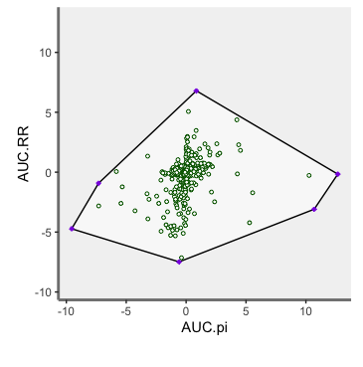
Response Diversity
Reaction
Response diversity RD = Var(Reaction Norm of species)
Response diversity RD = Var(spec. Stab)
Stressor
Var(spec. resp)
Var(spec. resp)
Instability
Instability
Response diversity
Response diversity

Slide 2
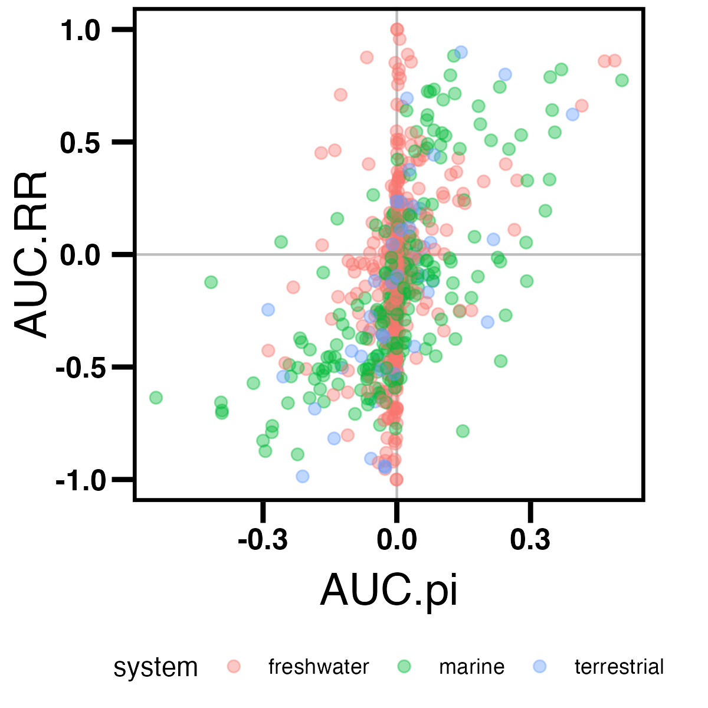
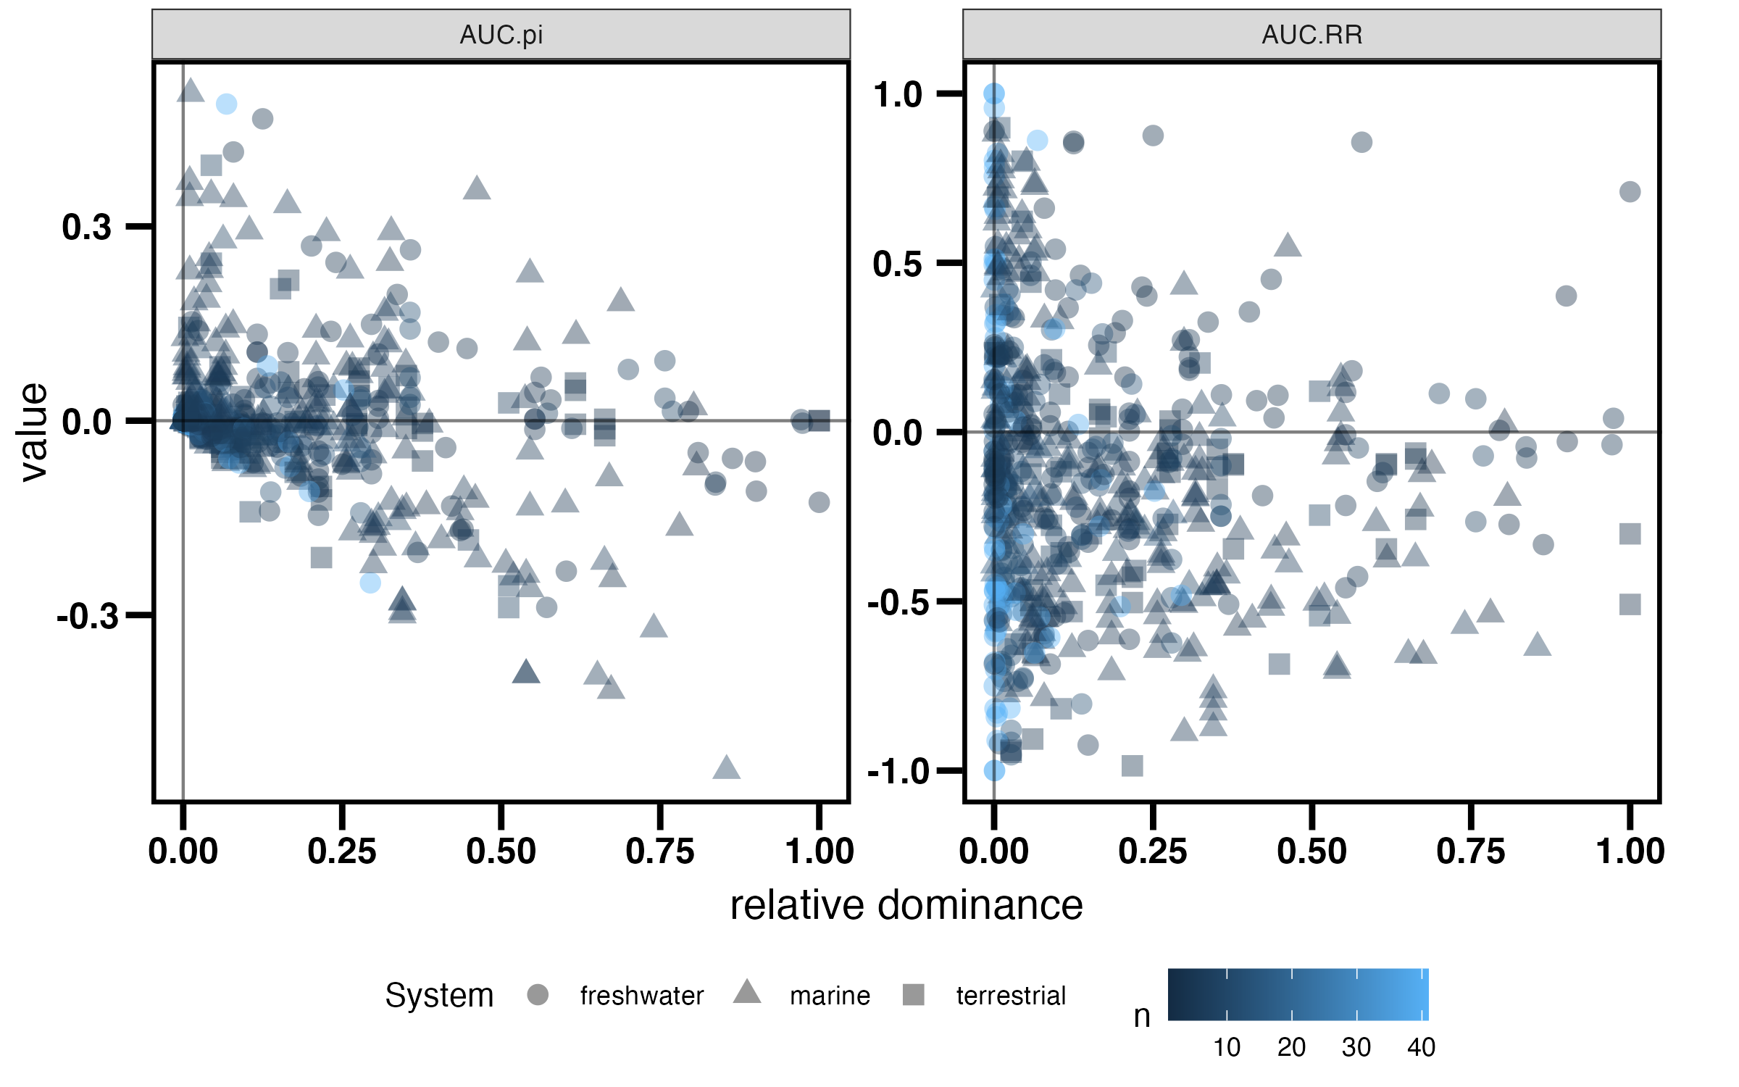
MA on community stability
Aim: Cross-system–cross-organism analyses to determine the importance of species trait distributions for community stability in different realms (i.e. marine and terrestrial).
Using Vote counts on how many species show which response to pulses and dependency on systems, etc.
Does the relative dominance of species explain their responses/ do we find compensatory dynamics?
Can we quantify to which extent community (in)stability (OEV) emerges from species response diversity?
To-Dos:
Vote count MA?
Correlations of species cont ~ OEV/ rel. dominance
…

Slide 3
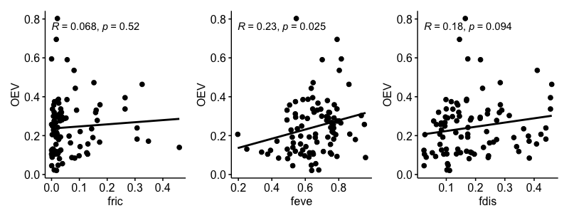
MA on community stability
Diversity of responses using a trait based approach
Axis 1: Relative contribution to stability
Axis 2: Absolute contribution to stability
To-Dos:
MA OEV ~ Fdiv model simplification
Pretty plots
Correlation of Functional RD ~ community instability (OEV) not great – MA non significant
→ Is this the right Response Diversity?

Slide 4
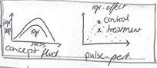
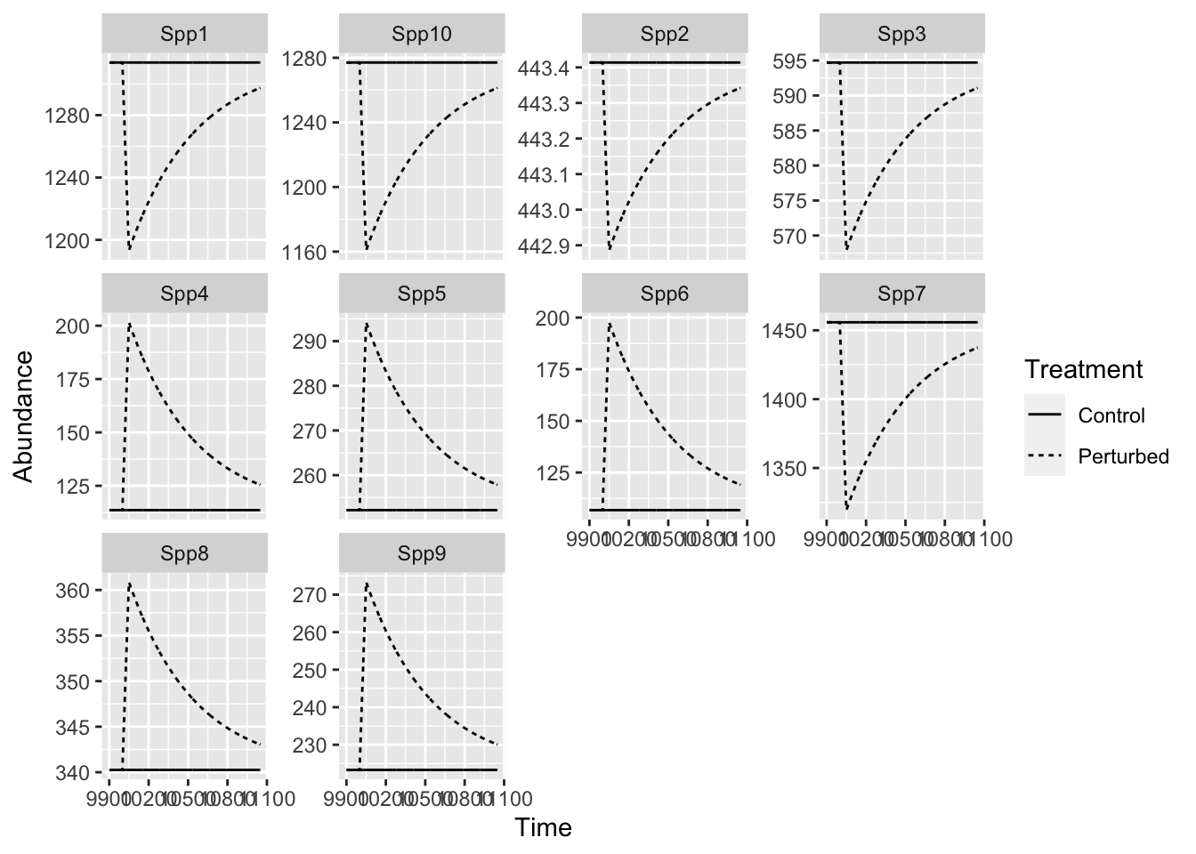
Does response diversity explain community (in)stability?
species Realised/ net response diversity (AUC.RR)
species Fundamental/ absolute response diversity
Measuring response diversity for pulse perturbations and within communities (realised) requires some explanation and methodological exploration
→ SIMULATIONS

Slide 5
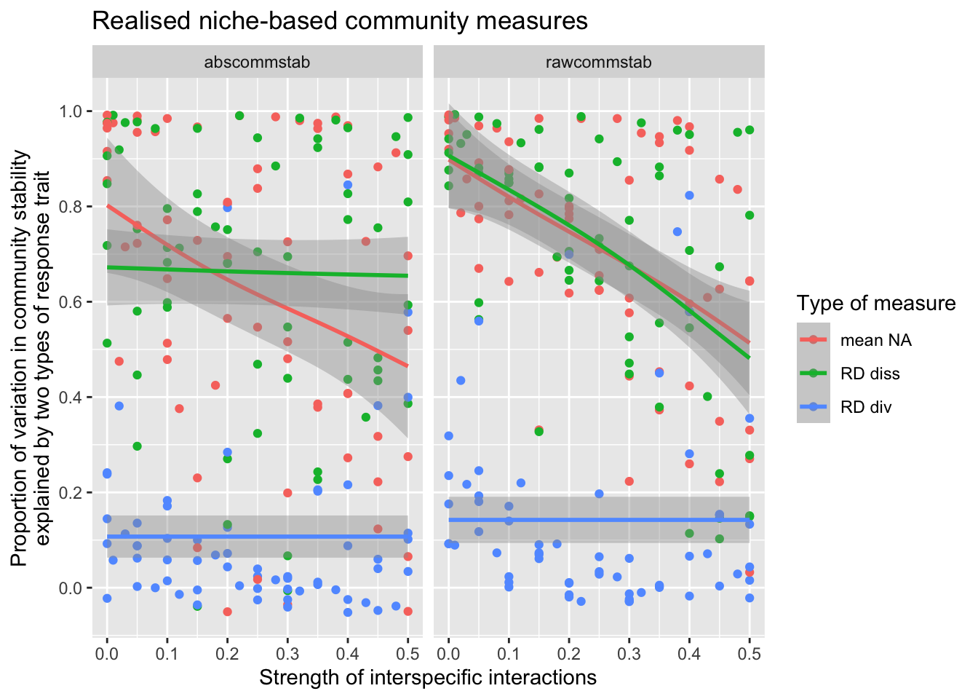
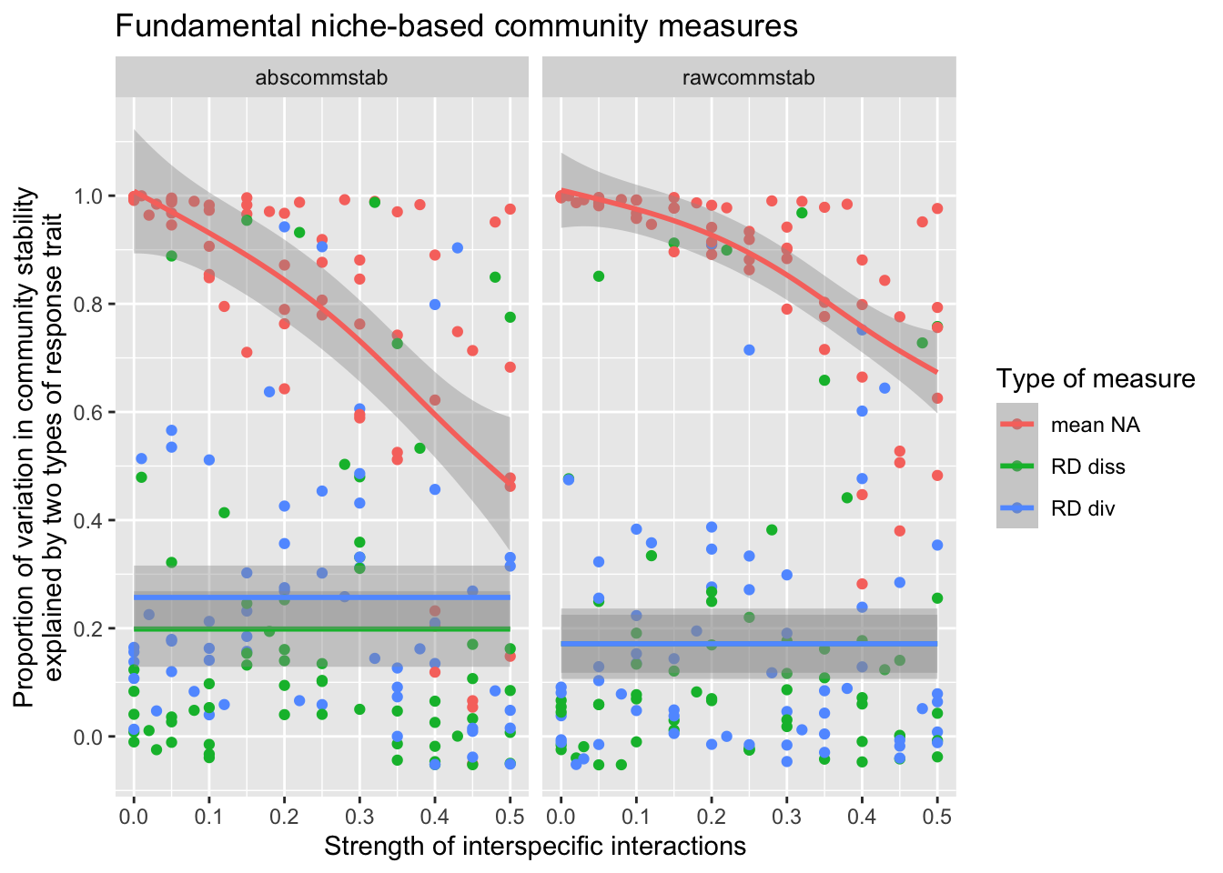
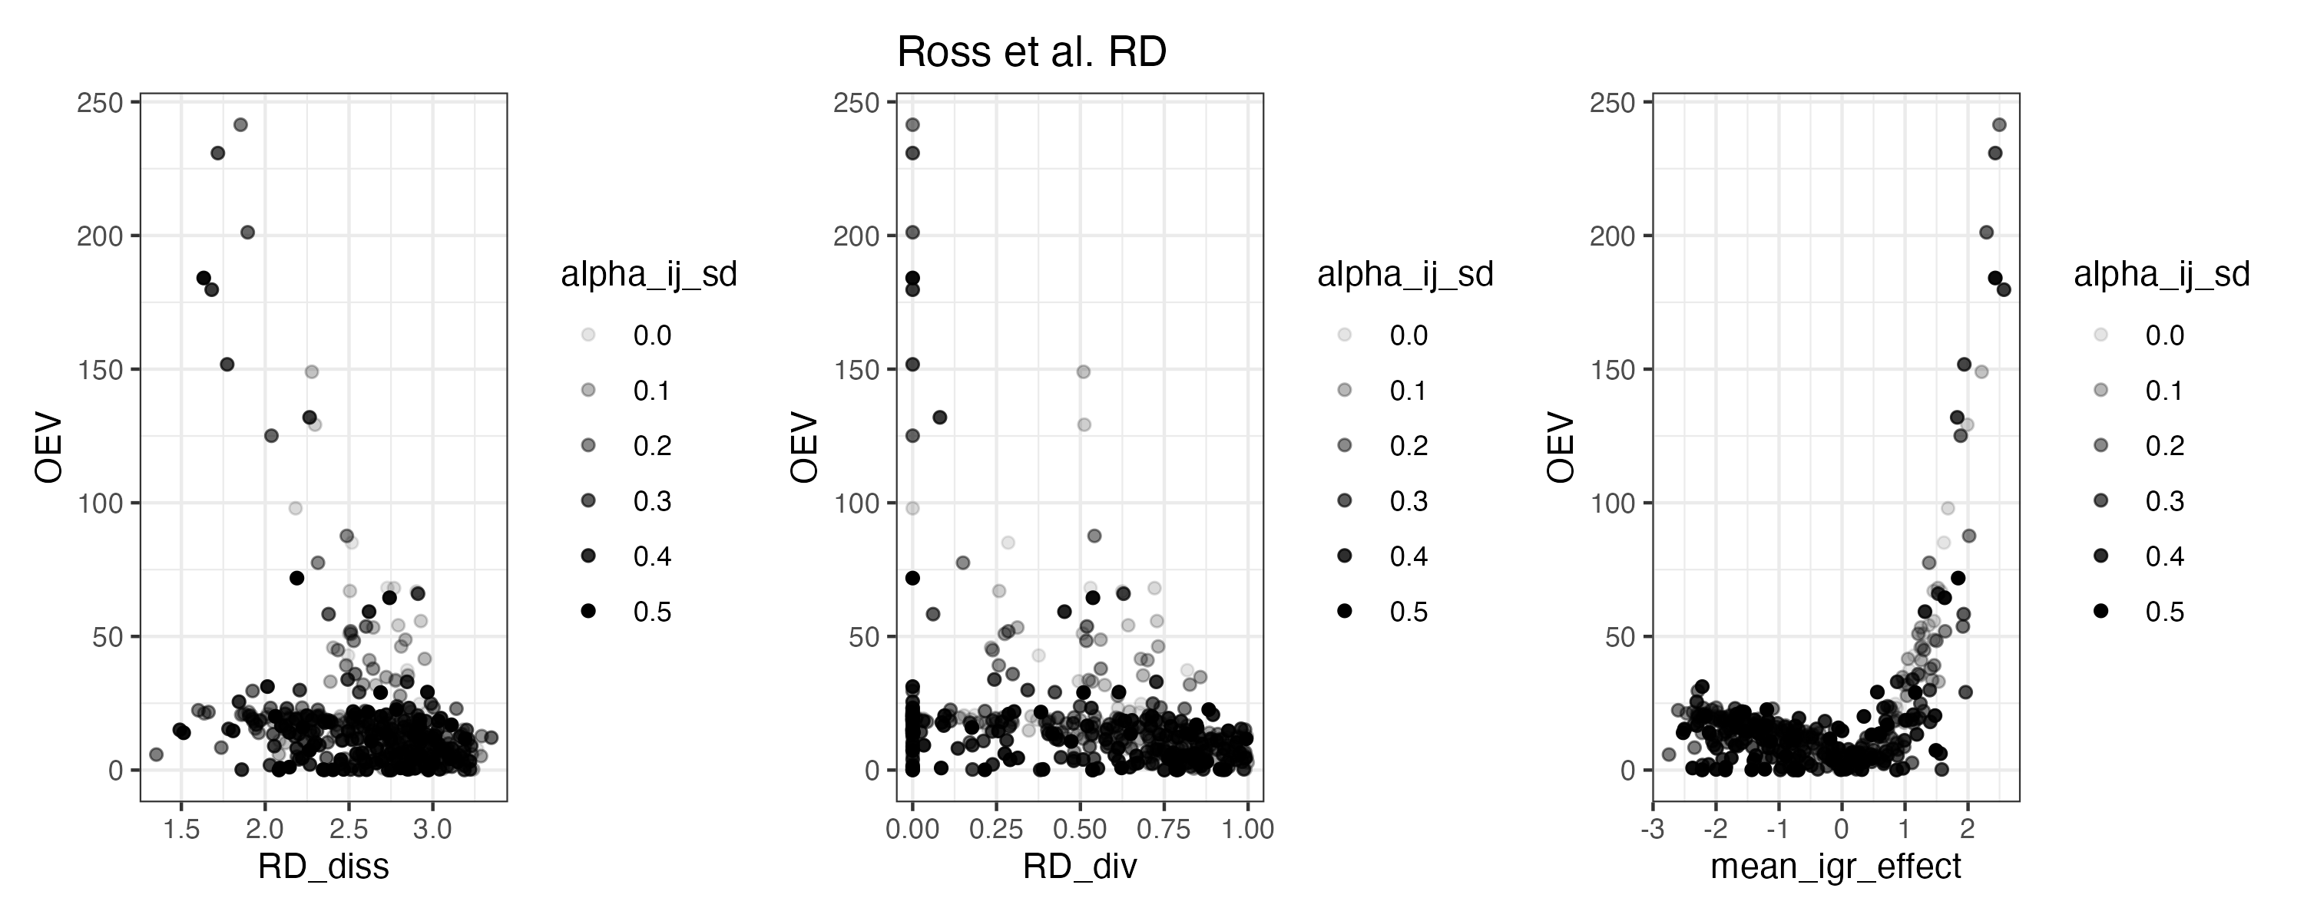
Simulations
To-Dos:
Charly learns the model dynamics
Pretty plots
Realistic interaction strenghts

Slide 6
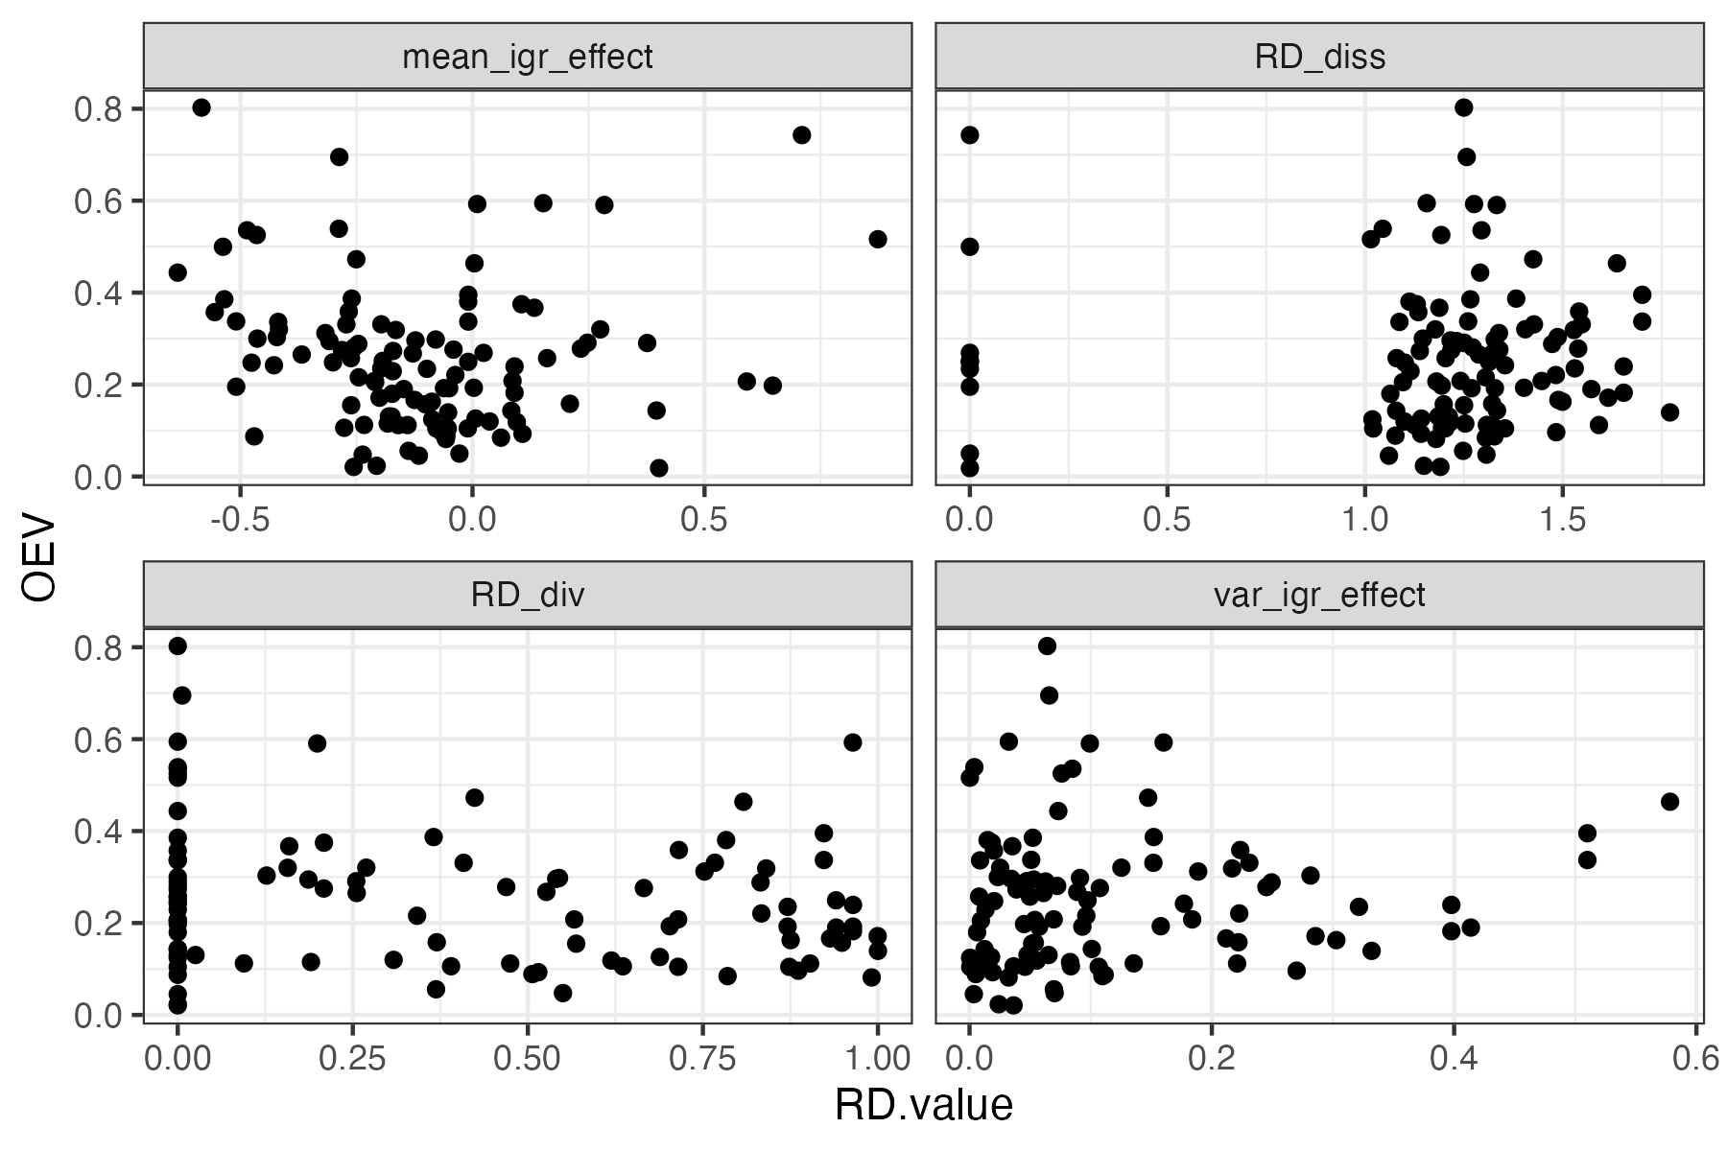
Simulations & Empirical Data
To-Dos:
Open Questions
Key take-aways
Conceptual figure
MA ?
Response diversity is not a useful concept for pulse perturbations.

Slide 7

Summary
To-Dos:
Vote count MA?
Correlations of species cont ~ OEV/ rel. dominance
To-Dos:
Charly learns the model dynamics
Pretty plots
Realistic interaction strenghts?
To-Dos:
Open Questions
Key take-aways
Conceptual figure on RD (Fdiv and Ross)
MA ?
To-Dos:
MA OEV ~ Fdiv model simplification
Pretty plots

Slide 8
Summary
OIST Workshop
Interaction strenght using the BIODEPTH data
MS3

Slide 9
Summary
OIST Workshop
Interaction strenght using the BIODEPTH data
MS3
Applications
NBES
NBES on resistance
Temporal variability and Resistance
Second draft???

Slide 10
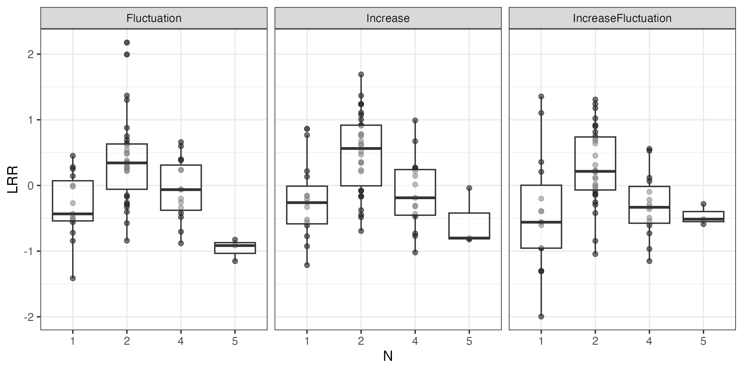
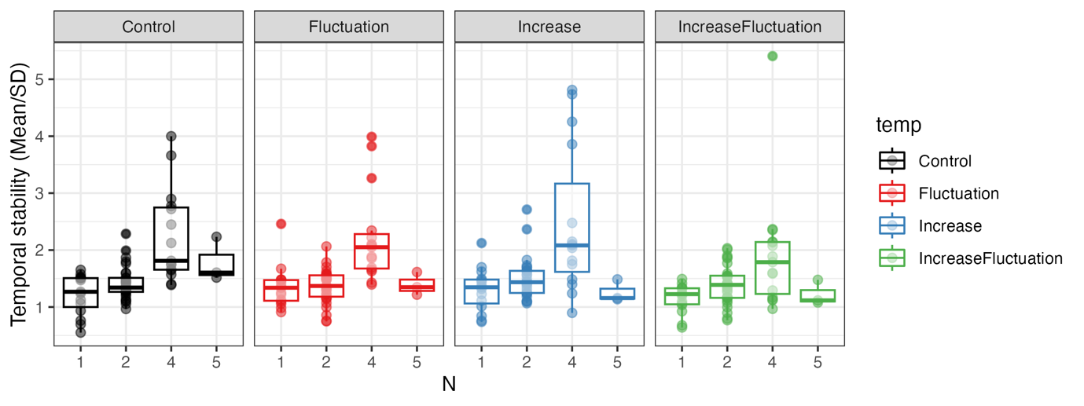
NBES → NBE on stability metrics

Slide 11
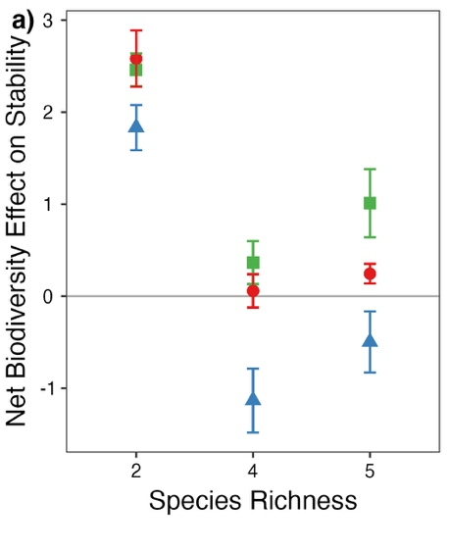
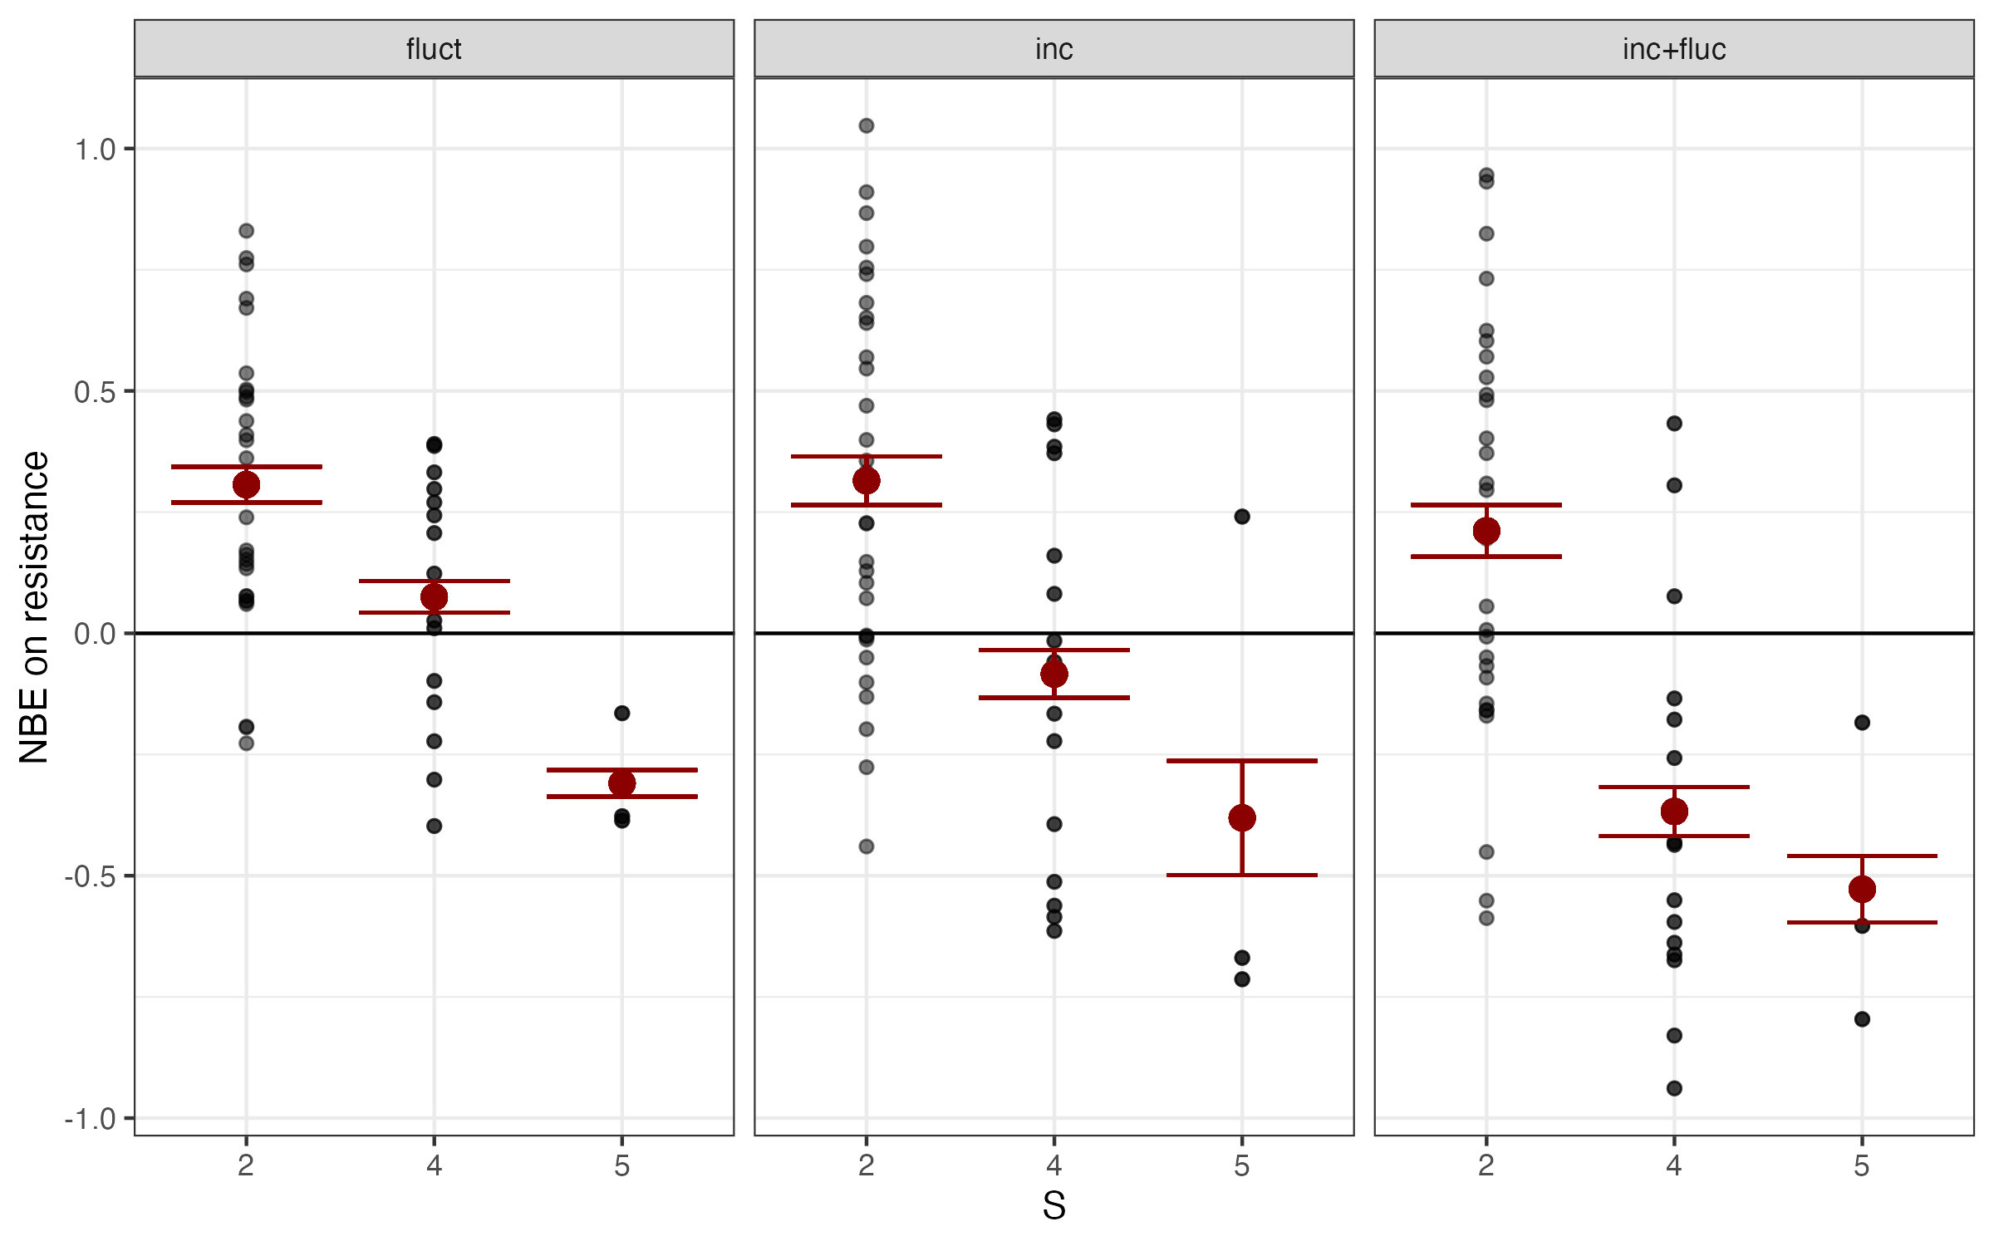
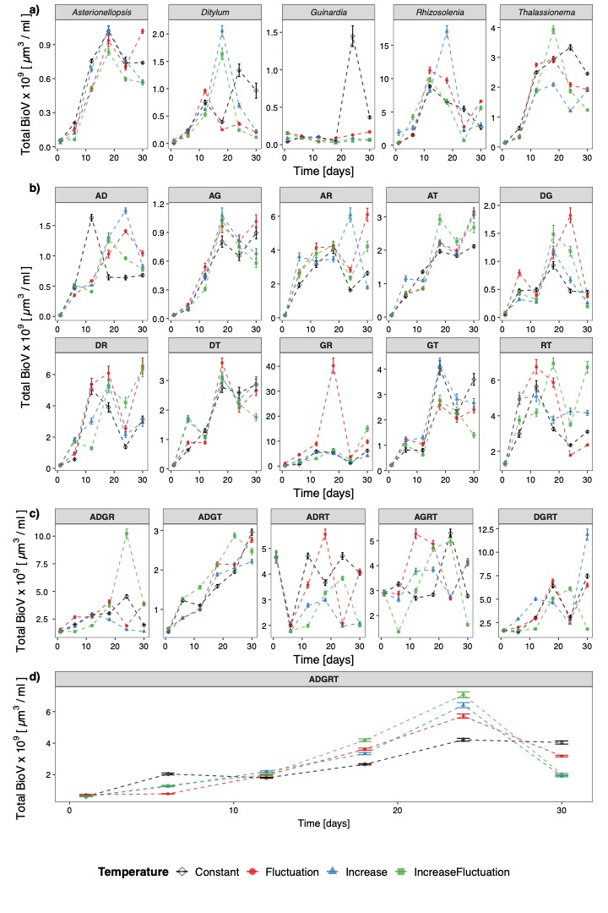
NBES → NBE on stability metrics
$$NBES=AUC\left(∆RR\right)=AUC(RRobs −RRexp)$$
$$NBE on resistance= ∆RR=RRobs −RRexp$$

Slide 12
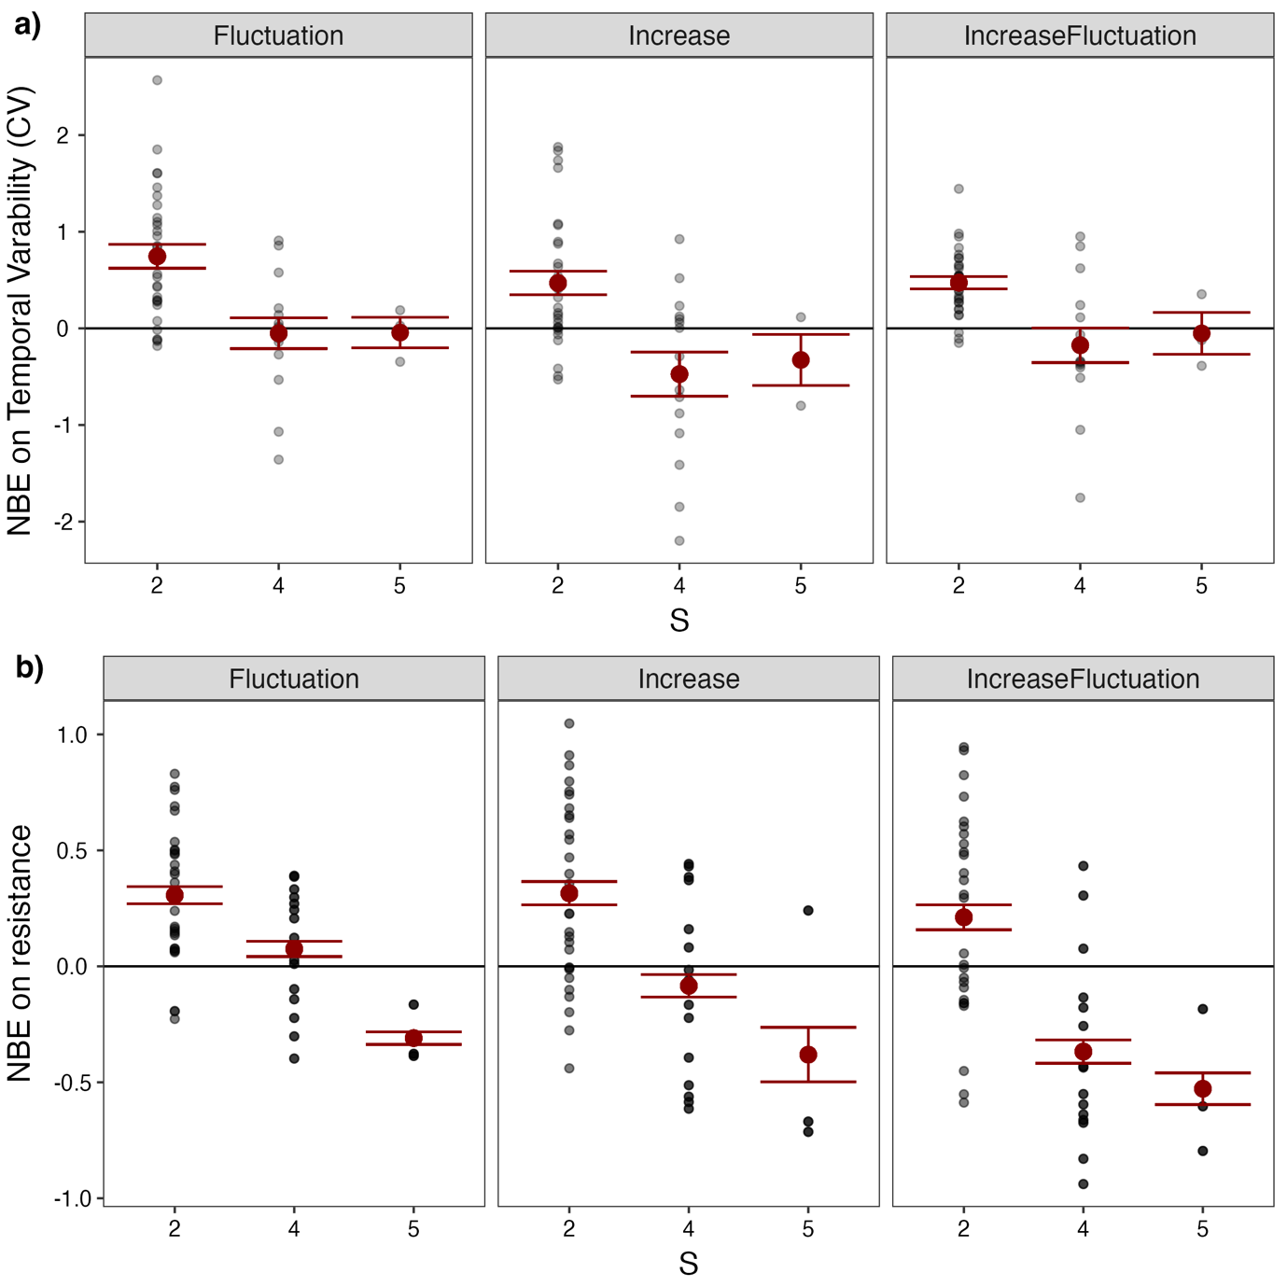
$$NBE on resistance= ∆RR=RRobs −RRexp$$
$NBE on CV=∆CV=CV(RRobs) −CV(RRexp$)

